Slide 1
Probabilistic pursuit on grid
Submittied by: Ramy Masalha
Based on “Probabilistic Pursuits on the grid” paper, By A.M. Bruckstein , C.L. Mallows , and I.A. Wagner.
https://www.researchgate.net/publication/2772452_Probabilistic_Pursuits_on_the_Grid

Slide 2
A(ge)nt system introduction
There are N agents.
First a(ge)nt follows an arbitrary path from the origin S=$(0, 0)$ to some target T=($T_{x}, T_{y})$ on the grid, jumping from point to point at each time unit.
For simplicity, Agent locations on the grid will be encoded as complex numbers: $A_{n}\left(t\right)=x_{n}\left(t\right)+i∗y_{n}\left(t\right)$, where $i=\sqrt{−1}$.
After each $\text{∆}≥2$ (integer) time units, a new agent starts moving.
Agent $A_{n+1}$ chases agent $A_{n}$, by making jumps according to the following probabilistic rule:

Slide 3
Suppose $A_{n}$ is at distance $(\text{∆}$x, ∆y) from $A_{n+1}$, then the next position of $A_{n+1}$ is determined by: $A_{n+1}\left(t+1\right)=A_{n+1}\left(t\right)+δ_{n+1}(t+1)$, where $δ_{n+1}\left(\right)$ are random variables taking values in $\left\{1, −1, i, −i\right\}$ according to:
$Prob\{δ_{n+1}\left(t+1\right)=sign(\text{∆}\text{x}\text{)\} = }$ $\frac{|\text{∆}\text{x}|}{|\text{∆}\text{x}+\text{∆}\text{y}|}$,
$Prob\{δ_{n+1}\left(t+1\right)=sign(\text{∆}\text{y}\text{)}\text{ * }\text{i}\text{\} = }$ $\frac{|\text{∆}\text{y}|}{|\text{∆}\text{x}+\text{∆}\text{y}|}$.

Slide 4
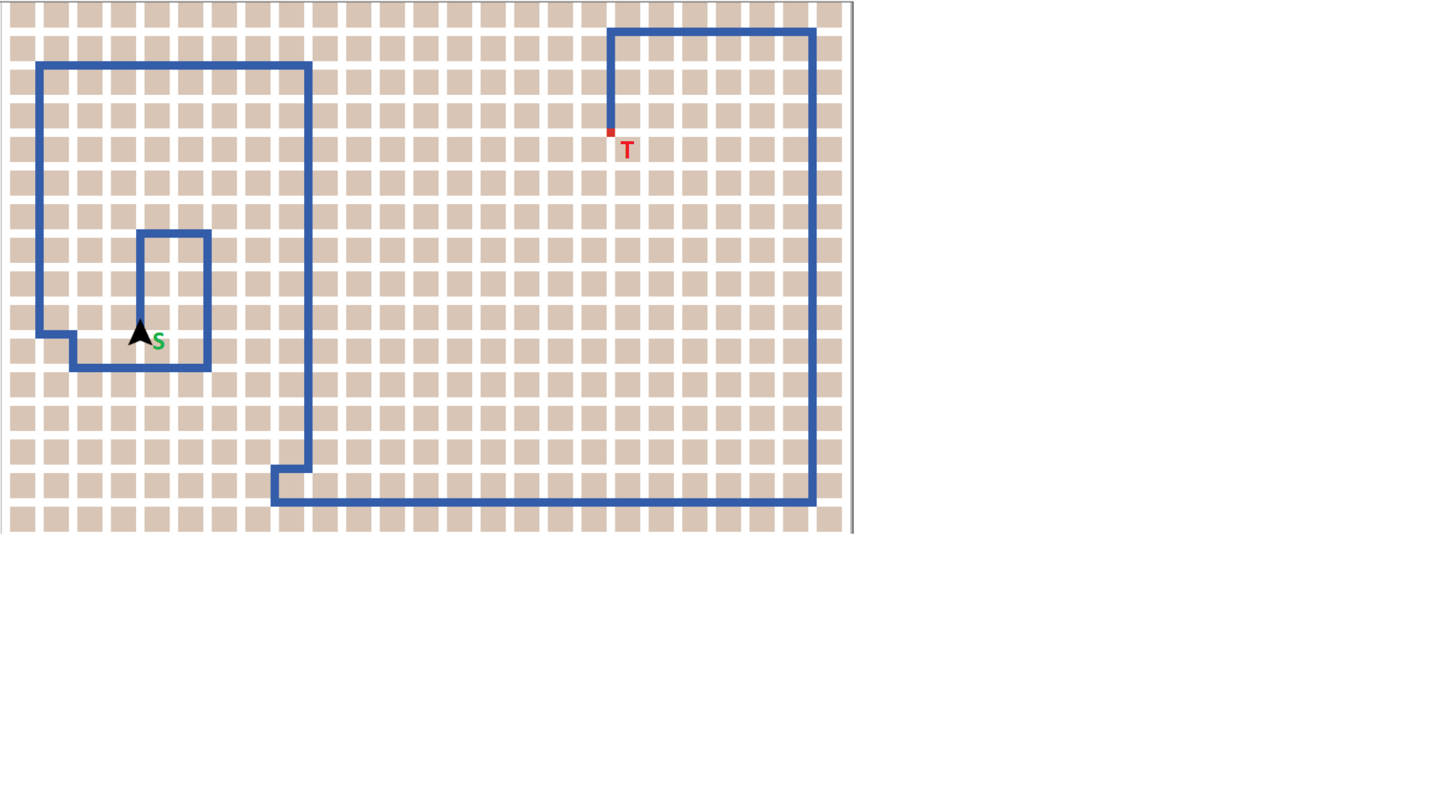
Figure – Initial path

Slide 5
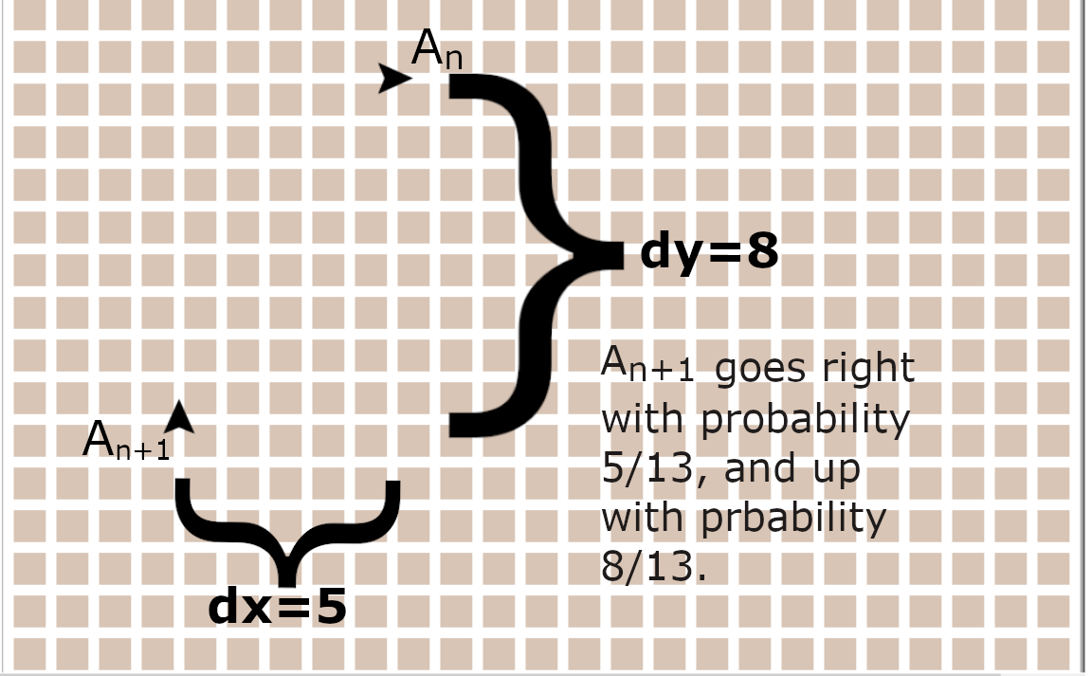
Figure – chase rule

Slide 6
Result 1 – The agents will converge very fast to take a shortest path on the grid from S to T
There are many shortest paths on the grid!
These paths are all the paths from S to T on with length $\left|T_{x}\right|+\left|T_{y}\right|$.

Slide 7
Proof summary – main ideas
Denote by $L\left(A_{n}\right)$ the length of the walk of the nth agent.
It is easy to see that $L\left(A_{n+1}\right)≤L\left(A_{n}\right)$.
Thus, it is enough to prove that the probability for having $L\left(A_{n+1}\right)<L\left(A_{n}\right)$ is bounded from below by some $ε>0$.

Slide 8
Suppose for ease of discussion that $T_{x}≥0, T_{y}≥0$.
A path will be called monotonic if it does not contain left or down steps.
Note that a path on the grid from S to T is a shortest path iff it is monotonic.

Slide 9
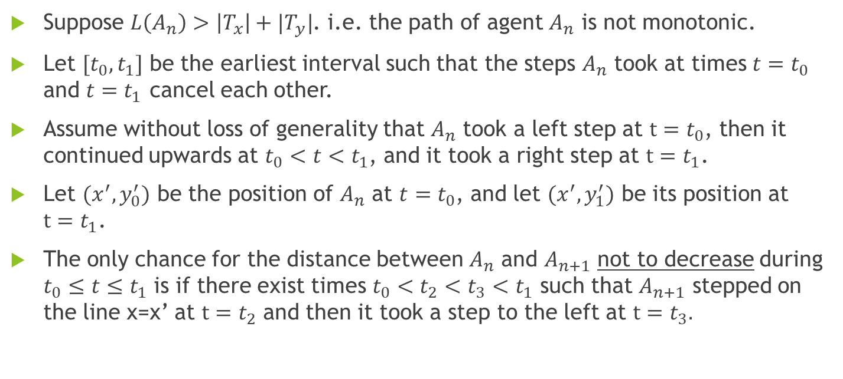
Suppose $L\left(A_{n}\right)>\left|T_{x}\right|+|T_{y}|$. i.e. the path of agent $A_{n}$ is not monotonic.
Let $[t_{0},t_{1}]$ be the earliest interval such that the steps $A_{n}$ took at times $t=t_{0}$ and $t=t_{1}$ cancel each other.
Assume without loss of generality that $A_{n}$ took a left step at $t=t_{0}$, then it continued upwards at $t_{0}<t<t_{1}$, and it took a right step at $t=t_{1}$.
Let $(x^{′}, y_{0}^{′})$ be the position of $A_{n}$ at $t=t_{0}$, and let $(x^{′}, y_{1}^{′})$ be its position at $t=t_{1}$.
The only chance for the distance between $A_{n}$ and $A_{n+1}$ not to decrease during $t_{0}≤t≤t_{1}$ is if there exist times $t_{0}<t_{2}<t_{3}<t_{1}$ such that $A_{n+1}$ stepped on the line x=x’ at $t=t_{2}$ and then it took a step to the left at $t=t_{3}.$

Slide 10
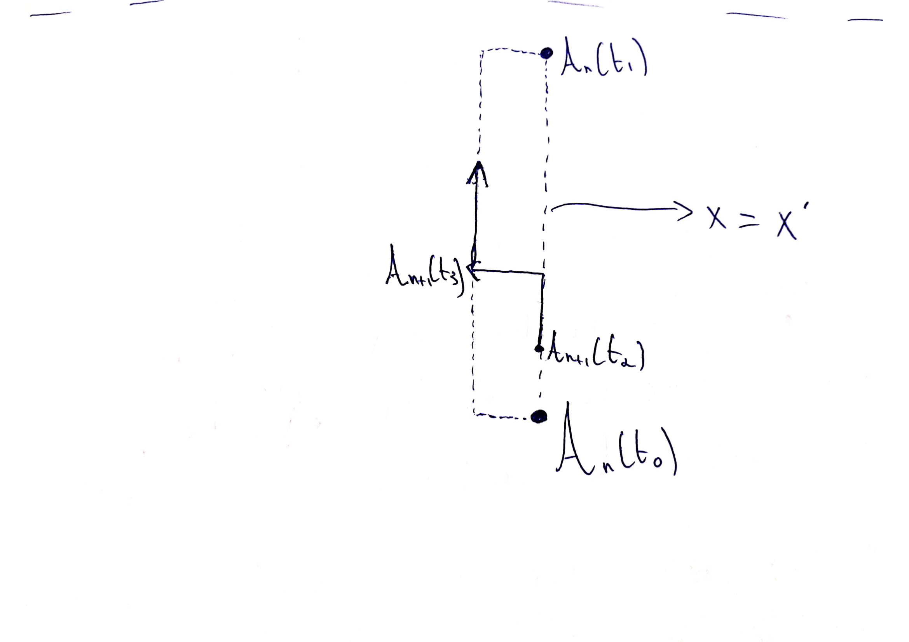
Figure – only chance for $d\left(A_{n}, A_{n+1}\right)$ not to get smaller

Slide 11
Therefore, if $A_{n+1}$ reaches the line $x=x′$ at $t=t_{2}$, and it “resists” not to go left during the time interval $[t_{2},t_{1}]$, then the distance between $A_{n}$ and $A_{n+1}$ is guaranteed to become smaller.
In other words, the probability for having $L\left(A_{n+1}\right)<L\left(A_{n}\right)$ is bounded from bellow by:
${\left|\frac{∆y}{∆x+∆y}\right|}^{t_{2}−t_{1}}={\left|\frac{∆y}{∆y+1}\right|}^{t_{2}−t_{1}}≥{\left(\frac{∆−1}{∆}\right)}^{t_{2}−t_{1}}≥{\left(\frac{∆−1}{∆}\right)}^{L\left(A_{n}\right)}≥{\left(\frac{∆−1}{∆}\right)}^{L\left(A_{0}\right)}$.
Q.E.D

Slide 12
Result 2: The stationary path-distribution is uniform.

Slide 13
Proof summary – main ideas
The paths followed by successive ants form a Markov chain, with the state-space being all paths from the origin to T.
It can be shown that this chain is irreducible and aperiodic (and therefore ergodic)
We shall prove that the uniform distribution over the set, A, of monotonic paths is stationary.

Slide 14
Analogy
Suppose we have a supply of black and white balls, and a series of urns $U_{0},U_{1}, U_{2},…$, which initially are all empty. At time $t=1, 2, …, \left|T_{x}\right|+\left|T_{y}\right|$, an agent $A_{0}$ places a ball, either white or black, into $U_{0}$. At each time $∆, ∆+1, …$, agent $A_{1}$ takes a ball at random from $U_{0}$ (which at time $∆$ contains $∆$ balls) and places it in $U_{1}$. At each time $2∆, 2∆+1, …$, agent $A_{2}$ takes a ball at random from $U_{1}$ and places it in U2, and so on. For each urn, the number of balls it contains starts by rising from zero to $∆$, stays there a while, and then decreases to zero.

Slide 15
This description is equivalent to that of probabilistic pursuit, if we take a white ball for a right-step and a black ball for an up-step, and identify the position $A_{n}\left(t\right)$ with w + ib where w (respectively, b) is the total number of white (respectively, black) balls this agent has seen by time t. The number of white (black) balls in urn $U_{n−1}$ corresponds to the x (y) position of $A_{n−1}$ relative to $A_{n}$.

Slide 16
Proof continued – main idea
Suppose the path of the pursued target, $A_{0}$, is chosen uniformly from the set of all monotonic paths, A, e.g., by drawing from an urn with $T_{x}$ white and $T_{b}$ black balls, and moving right on white and up on black.
Using the urn representation, we can obtain the distribution over all possible paths for the kth ant by considering a sequence of urns $U_{0},U_{1},…, U_{k}, …$ with the black and white balls being moved downstream, as described earlier.
The distribution of paths for the kth agent is given by the distribution of ball-color sequences seen entering the urn $U_{k}$ in this process.
Disregarding the color of balls, by symmetry all (a + b)! sequences of balls are equally probable to appear as inputs to $U_{k}$
Hence, all possible sequences of black and white balls are also equiprobably seen entering the kth urn. Q.E.D

Slide 17
Result 3: Assuming stationarity, the average path is the straight line from origin to target, and agents are usually very near the average path.

Slide 18
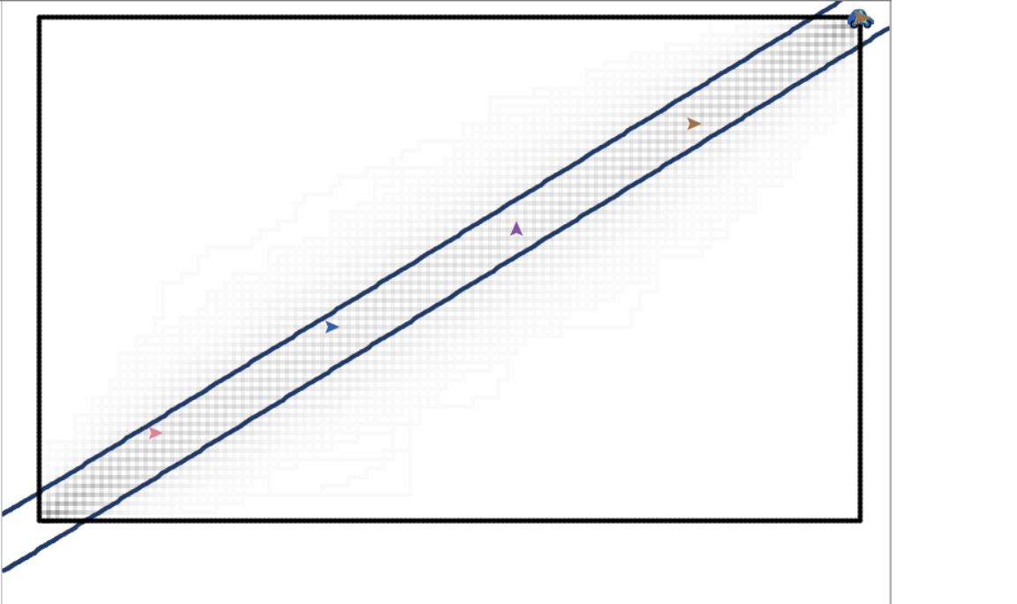
Figure – agents are usually very near the average path. Gray level of the patches depicts the percentage of agents stepped on the corresponding patch.

Slide 19
Result 4: Assuming stationarity, the probability for an agent to step on coordinate (x, y) on the grid (when $0≤x≤T_{x}, 0≤y≤T_{y}$) is:
$\left({x+y \atop x}\right)∗$ $\left({T_{x}+T_{y}−x−y \atop T_{x}−x}\right)$
This result stems from the fact that the stationary path-distribution is uniform, and that the number of paths on the grid from origin to $\left(T_{x}, T_{y}\right)$ passing in coordinate (x, y) is given by $\left({x+y \atop x}\right)∗$ $\left({T_{x}+T_{y}−x−y \atop T_{x}−x}\right)$

