Slide 1
Project On Multi-A(ge)nt Systems (236824)
On paper:
Yu, W., Zheng, W. X., Chen, G., Ren, W., & Cao, J. (2011). Second-order consensus in multi-agent dynamical systems with sampled position data. Automatica, 47, 1496–1503.
by Vitaly Shalumov

Slide 2
Presentation Outline
Introduction and overview
Mathematical concepts
Main contribution
Simulations
Conclusions and personal thoughts

Slide 3
Introduction and overview
The cooperative behavior in biology is a well know phenomena (swarming, flocking, shoaling) . The main idea is the same – Synchronization of some properties of the group.
Realistic dynamical systems
Two way communication
Second-order dynamics
Time delays
Sampling time
Output feedback (unavailability of some states)

Slide 4
Introduction and overview (cont.)
Main literature observations
When using information of both the current and delayed position states, the sampled position of the multi-agent system converges faster than the standard consensus multi-agent system
In some systems, the consensus of a multi-agent system cannot be reached without delayed position information (under the given protocol), but it can be achieved with an even relatively small time delay by appropriately choosing the coupling strengths.
Basically, adding memory improves performance

Slide 5
Introduction and overview (cont.)
What does our paper include???
Uses the tools of algebraic graph theory.
Develops necessary and sufficient conditions for consensus of multi-agent system with second-order dynamics
Measures both the current and the sampled past state of the position (hybrid system)
No use of velocity measurement
Does not store the whole spectrum of the delayed position information for more than one sampling time at a time
Presents results that can be applied to undirected and directed graphs alike
By choosing the appropriate sampling period, a consensus of multi-agent system can be reached if and only if the sampling period is chosen from some particular time intervals

Slide 6
Mathematical concepts
Basic concepts of algebraic graph theory:
The weighted adjacency matrix G = (G_{ij} )_{N×N}
Only positively weighted directed graphs are considered
A directed path from node v_{i} to node v_{j} in G is a sequence of edges (v_{i},v_{i1}), (v_{i1},v_{i2}), . . . , (v_{il},v_{j}) in the directed network with distinct nodes v_{ik} , k = 1,2,..., l
A root r is a node such that for each node v different from r , there is a directed path from r to v
A directed tree is a directed graph, in which there is exactly one root and every node except for this root itself has exactly one parent
A directed spanning tree is a directed tree consisting of all the nodes and some edges in G
A directed graph contains a directed spanning tree if one of its subgraphs is a directed spanning tree
The Laplacian matrix L = (L_{ij})_{N×N} is defined by
$L_{ii}=−\sum_{j=1,j≠i}^{N}{L_{ij} }, L_{ij}=−G_{ij} ,j≠i$

Slide 7
Main contribution
Consensus protocol with both current and sampled position data:
${\dot{x}}_{i}\left(t\right)=v_{i}$
${\dot{v}}_{i}\left(t\right)=α\sum_{j=1}^{N}{G_{ij}\left(x_{j}\left(t\right)−x_{i}\left(t\right)\right)−β\sum_{j=1}^{N}{G_{ij}\left(x_{j}\left(t_{k}\right)−x_{i}\left(t_{k}\right)\right)= }}−α\sum_{j=1}^{N}{L_{ij}x_{j}\left(t\right)+β\sum_{j=1}^{N}{L_{ij}x_{j}\left(t_{k}\right)}}$
$t∈[t_{k},t_{k+1}) ,i=1,2,…N$
$t_{k}$ are the sampling instants satisfying 0 = t₀ < t₁ < · · · <$t_{k}$ < · · ·, and α and β are the coupling strengths. $t_{k+1}$− $t_{k}$ = T , where T > 0 is the sampling period
Definition 1. The consensus of the multi-agent system is defined as:
$\lim_{t→∞}\left\|x_{i}\left(t\right)−x_{j}\left(t\right)\right\|=0, \lim_{t→∞}\left\|v_{i}\left(t\right)−v_{j}\left(t\right)\right\|=0 ∀i, j=1,2,…N$
$η_{i}={(x_{i},v_{i})}^{T}, A=\left(\begin{matrix}0 & 1 \\ 0 & 0\end{matrix}\right), and B=\left(\begin{matrix}0 & 0 \\ 1 & 0\end{matrix}\right)$:
${\dot{η}}_{i}\left(t\right)=Aη_{i}−α\sum_{j=1}^{N}{L_{ij}Bη_{j}\left(t\right)+β\sum_{j=1}^{N}{L_{ij}η_{j}\left(t_{k}\right)}} , t∈[t_{k},t_{k+1}) ,i=1,2,…N$
$\dot{η}\left(t\right)=\left[(I_{N}⨂A\right)− α \left.(L⨂B\right)]η\left(t\right)+β\left.(L⨂B\right)η\left(t_{k}\right), t∈[t_{k},t_{k+1})$

Slide 8
Main contribution (cont.)
Consensus depending on the control gains, spectra of the Laplacian matrix, and the sampling period:
Theorem 2. Suppose that the network G contains a directed spanning tree. Then, second-order can be reached if and only if
$0<\frac{β}{α}<1$ and
$f\left(α,β,μ_{i},T\right)=\frac{{\left(β/α\right)}^{2}}{1−\left(β/α\right)}\left(\sin^{2}\left(d_{i}T\right)−\sinh^{2}\left(c_{i}T\right)\right)×{\left(cosh\left(c_{i}T\right)−cos\left(d_{i}T\right)\right)}^{2}$
$$−4\sin^{2}\left(d_{i}T\right)\sinh^{2}\left(c_{i}T\right)>0 ,i=2,…N$$
$c_{i}=\sqrt{\frac{\left|α\right|\left(\left\|μ_{i}\right\|−sign(α)ℛ(μ_{i})\right)}{2}}$, $d_{i}=\sqrt{\frac{\left|α\right|\left(\left\|μ_{i}\right\|+sign(α)ℛ(μ_{i})\right)}{2}}$
Corollary 2. Suppose that the network G contains a directed spanning tree and all the eigenvalues of its Laplacian matrix are real. Then, second-order consensus can be reached if and only if
$0<β<α$ and
$\sqrt{αμ_{i}}T≠kπ , i=2,…N, k=0,1,…$

Slide 9
Main contribution (cont.)
Remark 2. If all the eigenvalues of the Laplacian matrix are real, which includes the undirected network as a special case, then the condition $T≠\frac{kπ}{\sqrt{αμ_{i}}}$ , is very easy to be verified and applied.
Interesting: second-order consensus in the multi-agent system can be reached if and only if 0 < β < α and the sampling period T is not of some particular value.
The convergence rate around the critical points $T=\frac{kπ}{\sqrt{αμ_{i}}}$ is very slow.

Slide 10
Main contribution (cont.)
Corollary 3. Suppose that the network G contains a directed spanning tree and all the eigenvalues of its Laplacian matrix are real. Then, second-order consensus in system can be reached if $0<β<α$is satisfied and
$0<T<\frac{π}{\sqrt{αμ_{N}}}$
Surprise: second-order consensus cannot be reached in a general directed network with complex Laplacian eigenvalues for a sufficiently small or a sufficiently large sampling period T

Slide 11
Main contribution (cont.)
Remark 3. If the network G contains a directed spanning tree and all the eigenvalues of the Laplacian matrix are real, then second-order consensus can be reached for a sufficiently small sampling period T as stated in Corollary 2.
However, if there is at least one eigenvalue of the Laplacian matrix having a nonzero imaginary part, then second-order consensus cannot be reached for a sufficiently small sampling period T as shown in Corollary 4, which is inconsistent with the common intuition that the consensus protocol should be better if the sampled information is more accurate for a small sampling period.
Interestingly, the nonzero imaginary part of the eigenvalue of the Laplacian matrix leads to possible instability of consensus

Slide 12
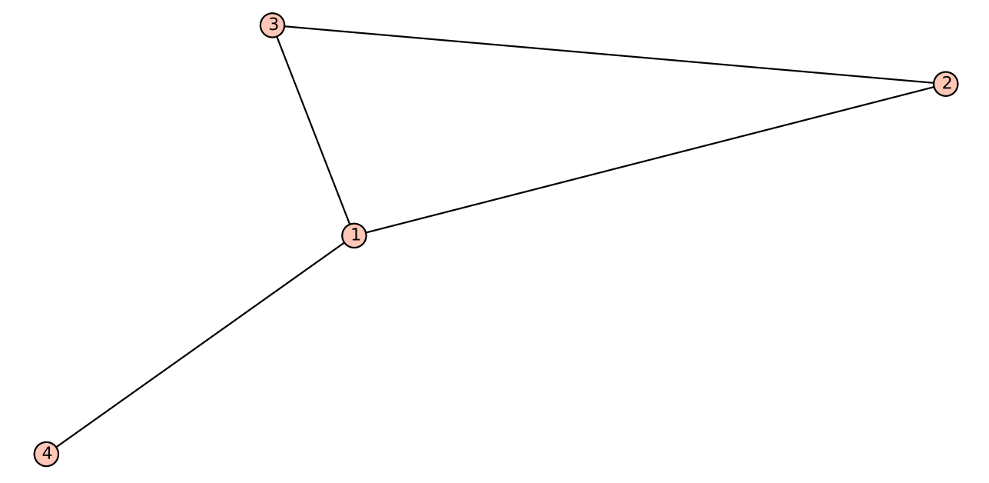
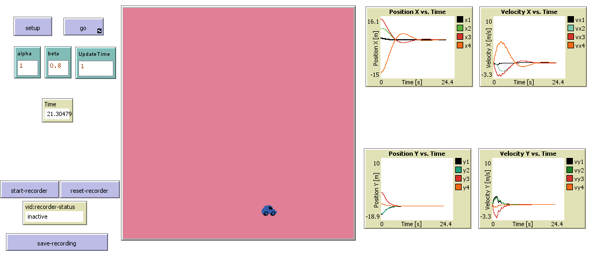
Simulations
Case 1
L | $$μ_{1}$$ | $$μ_{2}$$ | $$μ_{3}$$ | $$μ_{4}$$ | $$\frac{kπ}{\sqrt{αμ_{2}}}$$ | $$\frac{kπ}{\sqrt{αμ_{3}}}$$ | $$\frac{kπ}{\sqrt{αμ_{4}}}$$
$$\left(\begin{matrix}3 & −1 & −1 & −1 \\ −1 & 2 & −1 & 0 \\ −1 & −1 & 2 & 0 \\ −1 & 0 & 0 & 1\end{matrix}\right)$$ | 0 | 1 | 3 | 4 | 3.1416 | 1.8138 | 1.5708
 | Sample Time | $$α$$ | $$β$$ | Position and velocity | Is there consensus?
Case 1 | T=1[s] | 1 | 0.8 | Figure 1 | Yes
Case 2 | T=0.1[s] | 1 | 0.8 | Figure 2 | Yes
Case 3 | T= 1[s] | 1 | 1.1 | Figure 3 | No
Position and velocity states of the agents, Case 1.

Slide 13
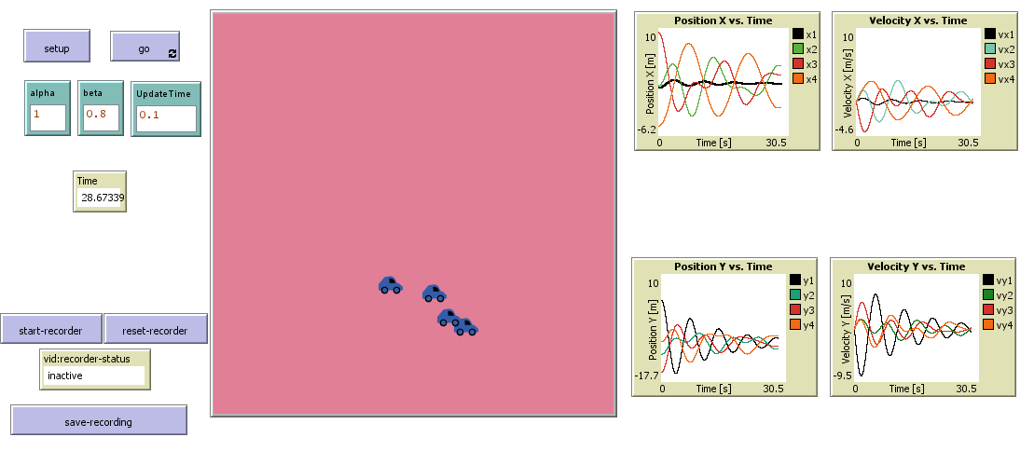
Simulations (cont.)
Case 2
L | $$μ_{1}$$ | $$μ_{2}$$ | $$μ_{3}$$ | $$μ_{4}$$ | $$\frac{kπ}{\sqrt{αμ_{2}}}$$ | $$\frac{kπ}{\sqrt{αμ_{3}}}$$ | $$\frac{kπ}{\sqrt{αμ_{4}}}$$
$$\left(\begin{matrix}3 & −1 & −1 & −1 \\ −1 & 2 & −1 & 0 \\ −1 & −1 & 2 & 0 \\ −1 & 0 & 0 & 1\end{matrix}\right)$$ | 0 | 1 | 3 | 4 | 3.1416 | 1.8138 | 1.5708
 | Sample Time | $$α$$ | $$β$$ | Position and velocity | Is there consensus?
Case 1 | T=1[s] | 1 | 0.8 | Figure 1 | Yes
Case 2 | T=0.1[s] | 1 | 0.8 | Figure 2 | Yes
Case 3 | T= 1[s] | 1 | 1.1 | Figure 3 | No
Position and velocity states of the agents, Case 2.

Slide 14
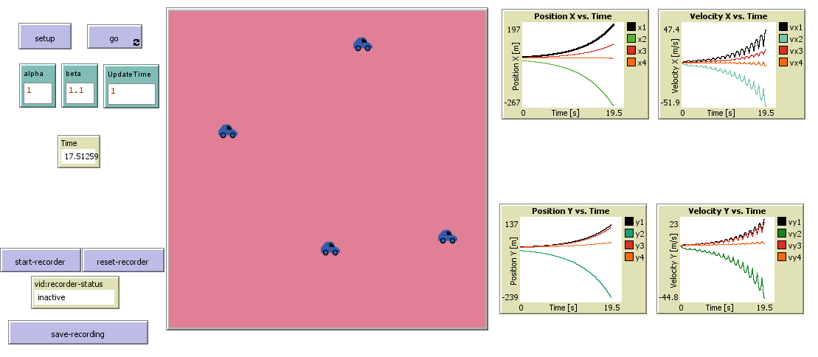
Simulations (cont.)
Case 3
L | $$μ_{1}$$ | $$μ_{2}$$ | $$μ_{3}$$ | $$μ_{4}$$ | $$\frac{kπ}{\sqrt{αμ_{2}}}$$ | $$\frac{kπ}{\sqrt{αμ_{3}}}$$ | $$\frac{kπ}{\sqrt{αμ_{4}}}$$
$$\left(\begin{matrix}3 & −1 & −1 & −1 \\ −1 & 2 & −1 & 0 \\ −1 & −1 & 2 & 0 \\ −1 & 0 & 0 & 1\end{matrix}\right)$$ | 0 | 1 | 3 | 4 | 3.1416 | 1.8138 | 1.5708
 | Sample Time | $$α$$ | $$β$$ | Position and velocity | Is there consensus?
Case 1 | T=1[s] | 1 | 0.8 | Figure 1 | Yes
Case 2 | T=0.1[s] | 1 | 0.8 | Figure 2 | Yes
Case 3 | T= 1[s] | 1 | 1.1 | Figure 3 | No
Position and velocity states of the agents, Case 3.

Slide 15
Conclusions and personal thoughts
If the eigenvalues of the Laplacian matrix are real, then consensus can be reached for any sampling period except at some critical points depending on the spectrum of the Laplacian matrix
If there exists at least one eigenvalue of the Laplacian matrix with a nonzero imaginary part, consensus cannot be reached for sufficiently small or sufficiently large sampling periods
Nevertheless some disconnected stable consensus regions can be determined by choosing appropriate sampling periods
Pros
A necessary and sufficient condition for reaching consensus in multi-agent dynamical systems with a general directed network topology is established and demonstrated
By using only sampled position data in this paper and without requiring the velocity information of agents in second-order dynamics, it is found in this paper that consensus can be reached by appropriately choosing the sampling period
Cons
No detailed analysis of the rate of convergence was given (the added simulation case presented interesting result: whether adding an edge increases or decreases the convergence rate is dependent on the sampling time
Only the graphs with directed spanning tree were analyzed, without addressing the graphs without a directed spanning tree
Future work
Non-uniform sampling intervals
Nonlinear dynamics with time-varying velocities
More general consensus protocols
Switching topologies
Optimal convergence time

Slide 16
Questions?

